Slide 1
NATIONAL SRHR SUMMIT
SECURING THE SEXUAL AND REPRODUCTIVE HEALTH AND RIGHTS OF MARGINALIZED GIRLS IN NIGERIA

Slide 2
INTRODUCTION
Today, we gather to shed light on an important topic: the sexual and reproductive health and rights (SRHR) needs of marginalized women and girls in Nigeria. We aim to raise awareness, advocate for their rights, and address the challenges faced by women and girls who are often overlooked or neglected.
In our presentation, we will specifically focus on three vulnerable groups: women and girls with disabilities (LWDs), those living with HIV, and those experiencing displacement. We recognize that these individuals face unique barriers in accessing comprehensive SRHR services, and it is crucial to address their specific needs to achieve inclusivity and equality.

Slide 3
PURPOSE
Advocating for the SRHR needs of marginalized women and girls in Nigeria, including those with disabilities, living with HIV, and in displacement.

Slide 4
PRESENTATION AGENDA
Definition and Importance of SRHR.
Challenges Faced by Marginalized Women and Girls in Nigeria (NEEDS).
Advocacy and Policy Framework.
Best Practices and Success Stories.
Call to Action.

Slide 5
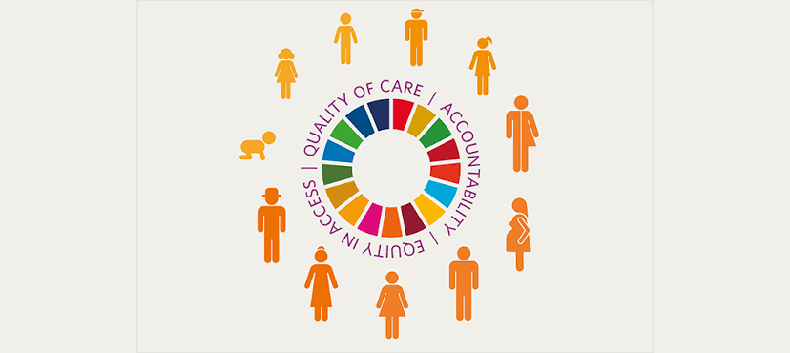
SEXUAL AND REPRODUCTIVE HEALTH AND RIGHTS (SRHR)
Sexual and Reproductive Health and Rights (SRHR) refers to the right of individuals to have control over their sexual and reproductive lives, including access to information and services related to contraception, safe abortion, maternal healthcare, and prevention and treatment of sexually transmitted infections (STIs).

Slide 6
IMPORTANCE OF SRHR
SRHR is crucial in ensuring the well-being and autonomy of women and girls because it empowers them to make informed decisions about their bodies, relationships, and future. It promotes their physical and mental health, supports gender equality, and enables them to fulfill not only their educational and economic potential but also the country's.

Slide 7
FACTS AND FIGURES
One in four women are victims of genital mutilation, and one in three women and girls aged 15 to 24 has experienced physical, sexual, or emotional violence.
107.3 per 1000 adolescents girls age 15-19 give birth yearly.
In 2021, there are 41,000 new HIV infections and 790,000 living with HIV recorded amongst women and girls aged 15-49.
82.1% of women who believe they should have final say in decisions regarding their own healthcare while only 46.3% of women aged 15-49 make decisions about their SRHR.
2.4% of women with disabilities in Nigeria have HIV, as compared to 1.4% of the men with disabilities44. This shows that women are more susceptible to sexually transmitted infections including HIV.
51.8% of general public reported discriminatory attitudes towards PLHIV.
In 2014, Nigeria passed the HIV and AIDS Anti-Discrimination Act, which protects individuals from discrimination based on HIV status. However, the Act does not adequately address the rights and needs of persons with disabilities.

Slide 8
SRHR NEEDS OF MARGINALIZED WOMEN AND GIRLS: Findings from VSI’s Rightholders’ Needs Assessment.
Establishment of Youth-Friendly SRHR Centers in all States: The lack of youth-friendly SRHR centers in all states presents a significant gap in providing appropriate and targeted services to young women and girls. By establishing these centers, we can create safe spaces where young individuals can access comprehensive SRHR information, counseling, and services that are specifically tailored to their unique needs. This would empower them to make informed decisions about their SRHR and foster a culture of well-being and empowerment among the youth.

Slide 9
B. Establishment of Safe Homes for Abused Girls: The absence of safe homes for abused girls, particularly those living with HIV and in displacement, leaves them vulnerable and without necessary support. By establishing safe homes, we can provide these girls with a secure environment where they can receive physical, emotional, and psychological assistance. These safe homes would offer a haven for healing, empowerment, and the opportunity to rebuild their lives free from violence and exploitation.

Slide 10
C. Implementation of Existing SRHR Policies: It is crucial that we prioritize the implementation of existing SRHR policies, particularly those formulated at regional and international levels. By effectively translating these policies into action at the national level, we can bridge the gap between policy and practice, ensuring that the rights and needs of women and girls are upheld. This requires collaborative efforts among stakeholders and duty bearers to create an enabling environment that supports the full realization of SRHR for all.

Slide 11
D. Availability of Interpreters for Girls with Hearing Impairment: To ensure inclusivity and accessibility in SRHR services, there's need for the availability of interpreters at clinics and IDPs camp for girls with hearing impairment. By removing communication barriers, we empower these girls to actively engage in their healthcare decisions, seek information, and access quality SRHR services. It is essential to promote a healthcare system that caters to the diverse needs of all individuals, including those with disabilities.

Slide 12
E. Demystification of Disabilities: We must actively work towards demystifying disabilities to combat stigma and misconceptions surrounding individuals with disabilities. Education and awareness campaigns are key in promoting understanding, empathy, and inclusivity. By fostering a society that values and respects the rights of persons with disabilities, we can create an environment where women and girls with disabilities are empowered to fully participate in all aspects of life, including their SRHR.

Slide 13
EMPOWERING EDUCATION AND LEGISLATION
Importance of inclusive education for persons with disabilities, including those living with HIV and in displacement.
Implementing disability, anti-discrimination, and HIV/AIDS Acts such as Discrimination Against Persons with Disabilities (Prohibition) Act 2018, Nigerian Disability Rights Law, HIV/AIDS Anti-Discrimination Act of 2014, UNAIDS Policy Position on HIV/AIDS, and United Nations Convention on the Rights of Persons with Disabilities (CRPD).
Reviewing existing laws for inclusivity of marginalized groups such a the Fundamental Human Rights.
Implementation of the Violence Against Persons Prohibition (VAPP) Act and its relevance to all marginalized women and girls.

Slide 14
SRHR ADVOCACY AND POLICY FRAMEWORK
Inclusive Policy Development: This includes ensuring their access to comprehensive healthcare services, including sexual and reproductive health services, HIV prevention and treatment, psychosocial support, and disability-inclusive services.
Sensitization and Training.
Accessible Healthcare Services.
Comprehensive Sexuality Education: This education should provide accurate and age-appropriate information on sexual and reproductive health, HIV prevention, healthy relationships, consent, and empowerment.
Collaboration and Coordination.
Monitoring and Evaluation: Establish monitoring and evaluation mechanisms to assess the effectiveness and impact of the implemented policies and programs. Regularly collect data on key SRHR indicators to identify gaps and inform evidence-based decision-making.
Advocacy and Awareness.

Slide 15
BEST PRACTICES AND SUCCESS STORIES
Inclusive and Youth-Centered Approaches: Several organizations and initiatives under HIVOS have successfully adopted inclusive and youth-centered approaches to SRHR.
Tailored Services and Support: Several organizations and initiatives have successfully adopted inclusive and youth-centered approaches to SRHR through the help of the We Lead Program.
Multi-Sectoral Partnerships: Enhance advocacy efforts by bringing together diverse perspectives and amplifying the voices of marginalized girls.
Community Engagement and Awareness.
Empowering Education: By promoting open dialogue and breaking down taboos, CSE empowers girls to protect themselves, make healthy choices, and advocate for their SRHR.
Data-Driven Approaches.
Legislative and Policy Reforms: Advocacy efforts that aim to change or reform legislation and policies have resulted in significant advancements in SRHR for marginalized girls.

Slide 16
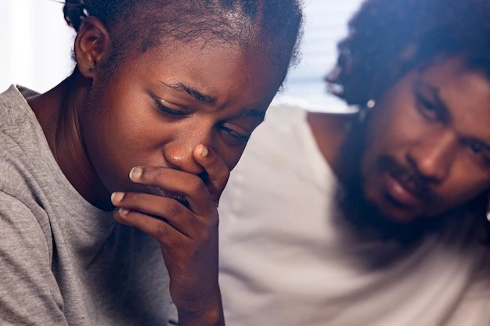
A REAL LIFE SCENARIO
OF A MARGINALIZEDGIRL LHIV

Slide 17
STRATEGIES FOR STAKEHOLDERS AND DUTY BEARERS
Establish a comprehensive national strategy that addresses the SRHR needs of marginalized women and girls, encompassing policies, programs, and funding.
1
Collaborate with with law enforcement personnel to develop swift and effective response to address sexual violence against marginalized girls, including those living with HIV and displaced.
GOVERNMENT
AGENCIES
Allocate adequate resources for the establishment and maintenance of accessible healthcare facilities in marginalized communities, considering their specific needs and challenges.
Foster partnerships with NGOs and community organizations to implement targeted interventions and outreach programs, aiming to raise awareness and improve SRHR outcomes for marginalized women and girls.

Slide 18
Advocate for the rights of marginalized women and girls by engaging in public awareness campaigns, lobbying for policy changes, and conducting research to support evidence-based interventions.
2
Collaborate with government agencies and healthcare providers to ensure the provision of inclusive sexuality education programs that address the unique needs and challenges faced by marginalized women and girls.
NON
GOVERNMENTAL
ORGANISATIONS
(NGOs)
Establish safe spaces and support networks for marginalized women and girls, offering counseling, information, and referrals to healthcare services.
Foster capacity building initiatives for healthcare providers, enhancing their knowledge and skills in addressing the specific SRHR needs of marginalized women and girls.

Slide 19
Develop culturally sensitive and inclusive healthcare practices, fostering an environment that is non-judgemental,supportive and respects the dignity and SRHS of marginalized women and girls to promote inclusivity and remove barriers to care.
3
Providing free treatment for sexually transmitted infections to marginalized girls who have experienced abuse, including those living with HIV and displaced.
HEALTHCARE
PROVIDERS
Implement outreach programs to marginalized communities such as IDP camps, increasing access to healthcare services and ensuring that the unique needs of marginalized women and girls are met.
Foster collaborations with NGOs and community-based organizations to enhance the delivery of integrated SRHR services, ensuring comprehensive and person-centered care.

Slide 20
Recognize the significance of inclusive policies and legal frameworks that protect the SRHR rights of marginalized women and girls, ensuring their equal access to healthcare, education, and decision-making processes.
4
Review and implementation of existing policies on SRHR especially those made at regional and international levels. And also the implementation of the disability, anti-discrimination and VAPP Act.
POLICY
MAKERS
Advocate for budget allocations that prioritize the development of accessible healthcare facilities, comprehensive sexuality education programs, and the training of healthcare providers to meet the specific needs of marginalized women and girls.
Collaborate with government agencies, NGOs, and healthcare providers to monitor and evaluate the impact of policies and programs, ensuring continuous improvement and the realization of positive SRHR outcomes for marginalized women and girls.

Slide 21
UTILIZATION OF TECHNOLOGY AND MEDIA
Empowering survivors of sexual and gender-based violence by leveraging social media for anonymous reporting, ensuring confidentiality and safety.
Actively involving stakeholders in addressing the issue through digital platforms and awareness campaigns, fostering collaboration and collective action.
Giving marginalized women and girls a stronger voice by using media channels to amplify their stories, including those who face additional challenges such as disabilities, HIV, and displacement.

Slide 22
CALL TO ACTION
The importance of collaborative efforts in addressing the SRHR needs of marginalized women and girls
Engaging stakeholders and duty bearers in supporting SRHR needs.
Advocating for the implementation of youth-friendly SRHR centers, safe homes, and interpreter services for all marginalized groups
Promoting the review and inclusivity of existing laws to protect and empower marginalized women and girls
Supporting the provision of non-judgmental SRHR services and urgent response to sexual violence for all marginalized groups
Emphasizing the need for accessible and free treatment for sexually related infections.
Ensuring availability of a minimum package of care and one-stop centers for marginalized girls, including those living with HIV and in displacement.

Slide 23
REFERENCES
United Nations Population Fund (UNFPA), 2021
World Bank, 2020
The African's Women Development and Communications Network. FEMNET. 2022.
Research Gate, 2018
Vision Spring Initiatives. 2023
United Nations. 1979. Convention on the Elimination of All Forms of Discrimination against Women. United Nations General Assembly. http://www.un.org/womenwatch/ daw/cedaw/
WHO, Gender and human rights. www.who.int/reproductivehealth/topics/gender_rights/sexual_health/en/

Slide 24
THANK YOU🤗
Vision Spring Initiatives (VSI)
info@vsinigeria.org
Instagram: vsi_ng
Twitter: vsi_ng
Facebook: Vision Spring Initiatives
LinkedIn: Vision Spring Initiatives

